Slide 1
Combatting Online Hostile Posts in Regional Languages
Mentor : Punyajoy Saha
Team : Kanishk Singh
Ganesh Shiridi Balaji Udayagiri
Jalend Bantupalli

Slide 2
Problem Description
What is an online community ?
An online community or internet community is a group of people with a shared interest or purpose who use the internet to communicate with each other. Online communities have their own set of guidelines and needs, like online community engagement, moderation, and management.
In this task we want to explore the role of online religious organisation in social media.

Slide 3
Our Contribution
Defined a new Model for Hostile speech detection
Created a new dataset for hostility detection
Hatescore calculation of a community (Explained in further Slides)

Slide 4
Related Work
Pretrained-LTMs in Text Classification : Pre-trained transformers serve as general language understanding models that can be used in a variety of downstream NLP tasks.
Hostile Post Detection : Researchers have been studying hate-speech on social media platform such as Twitter in the past. Davidson et al studied the hate-speech detection for English.

Slide 5
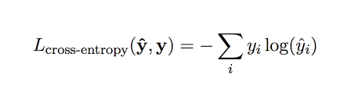
Methodology for Hostility Detection
Binary Classification : We consider each classification-task as an individual binary classification problem based on fine-tuned contexualised embeddings.
We fine-tuned the BERT transformer block and the classifier layer above it using the binary target labels for individual classes.
Binary cross-entropy loss used in the approach can be mathematically formulated as follows:

Slide 6
Task Overview
Online Posts
Hostile
Non Hostile
Fake
Defamation
Hate
Offensive
Structure of Task

Slide 7
Task Overview
The task focuses on a variety of hostile posts in Hindi Devnagri Script collected from Twitter.
The set of valid label-categories are:
Fake News : A claim or information that is verified to be not true.
Hate Speech : A post targeting a specific group of people based on their ethinicity, religious beliefs, geographic belonging, race,etc with malicious intentions of spreading or encouraging violence.
Offensive : A post containing profanity, impolite, rude or vulgar language to insult a targeted individual or group.
Defamation : A mis-information regarding an individual or group.
Non-hostile : A post without any hostility
In this task we want to explore the role of online religious organisation in social media.

Slide 8
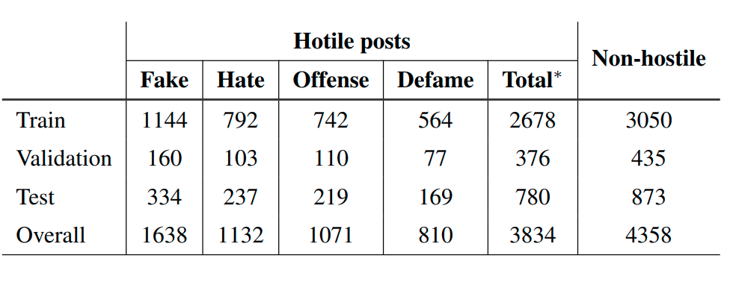
Dataset-Description

Slide 9
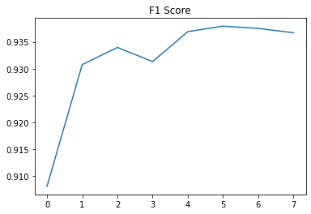
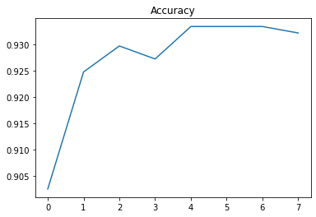
Training

Slide 10
Results
Method/Model | F1 Score
Baseline | 0.8422
Indic Bert | 0.9520
Hindi Bert | 0.9359

Slide 11
Model-Evaluation for collected-tweets
Dataset-Creation: We evaluated the prediction-labels using our trained model on the extracted tweets.
Back-feeding the ground-truth : We annotated 100 examples per week accumulating 400 manually annotated tweets and back-feeded into model.
Total Hostile Labels with confidence score > 0.85 : 4885/8071
Inter-Annotator Agreement : Cohen’ score : 0.5149

Slide 12
Tasks and Timeline
Getting familiar with the twitter API and twitter extraction APIs
Extracting all the followers of “AzaadBharatOrg” along with their tweets.
Extracting all the followers of AzaadBharatOrg
On the tweets extracted, topic modelling is executed.
Extracting all the followers who retweeted the AzaadBharatOrg tweets
Creating the complex network where the nodes are the persons who retweeted the tweets of the above account and a edge between the nodes denotes that both persons have retweeted at least one common tweet.
Network Analysis

Slide 13
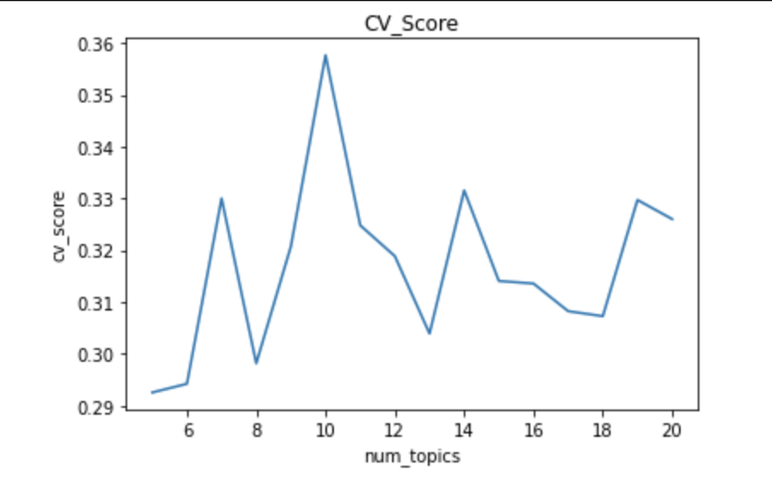
Topic Modelling
Plot of Coherence Score with respect to Number of topics -------->
Topics (with k=10) gave the highest Coherence score - 0.357
(10,0.357)

Slide 14
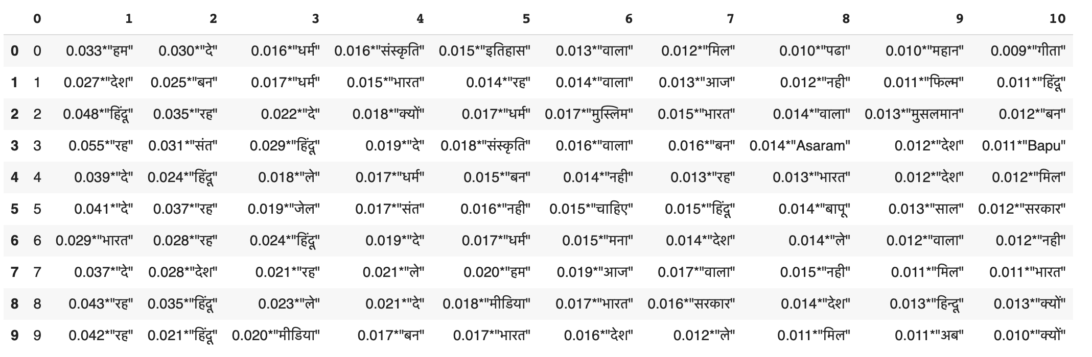
Topics

Slide 15
New Definitions
Hatescore of a user : Number of retweets which a user made which were labelled as hostile by the trained model.
Hatescore of a community : Sum of hate scores of users in a community
Normalized Hatescore : Hate score of a community divided by the number of users in that community.

Slide 17
Network Description
We created an undirected weighted graph for the followers.
The nodes represent the followers of certain Twitter religious organizations who retweeted their tweets.
An edge between two followers indicates that they have retweeted the same tweet at least once.
The weight on the edge represents the number of times the two followers have retweeted the same tweet.
Node weight : Hatescore of the user.

Slide 18
Network Analysis
All the followers of different networks were plotted in a network.
Community detection algorithm is applied on this network to obtain the different communities.
It was observed that the community detection algorithms was giving the communities almost same as that of the twitter communities. Which is expected.

Slide 19
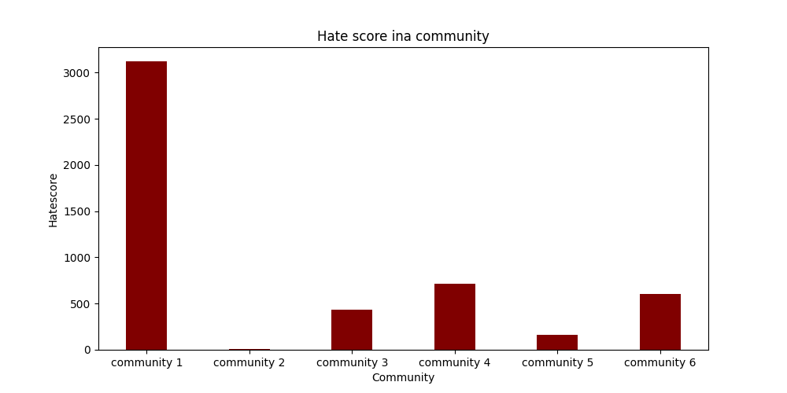
Results and observations

Slide 20
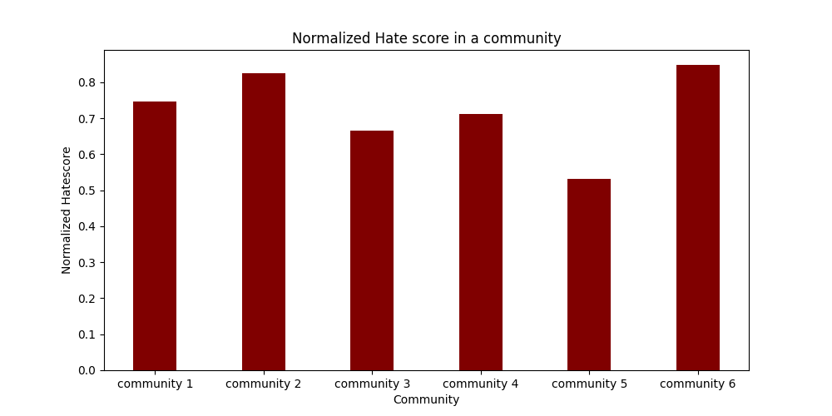

Slide 21
Thank You

